Slide 1

DESIGN AND EVALUATION OF AN AGENTIC AI COPILOT FOR DEALER PERFORMANCE ANALYTICS AND REPORTING IN AUTOCHEK AFRICA
Agentic AI for dealer analytics, scoring & recommendations
Supervisor : Dr. Grace Oletu Co-Supervisor : Mr. Jeremiah Ishaya
Presented by :
Regina Adobea Essien
Notes:
Introduce yourself. (Name, Final Year Student & Machine Learning and AI Practitioner)
Introduce the thesis title
Introduce Autochek Africa (our partnership with car dealers to sell car loans)

Slide 2
Overview
1
INTRODUCTION
5
METHODOLOGY
2
LITERATURE REVIEW
12
RESULTS
3
PROBLEM STATEMENT
14
CONCLUSION
4
AIMS & OBJECTIVES
Notes:
Outlines the structure of my presentation, from introduction and methodology to results and conclusion, with each section broken down into sub-sections for clarity.
1.I will begin with the introduction and literature review to provide some context.
2. Then I will present the problem statement and objectives of the study.
3. Next, I will discuss the methodology. Each section is further divided into sub-sections to clearly explain the different components of the system and the evaluation process.
4. Then we will conclude with key findings and insights from the study

Slide 3
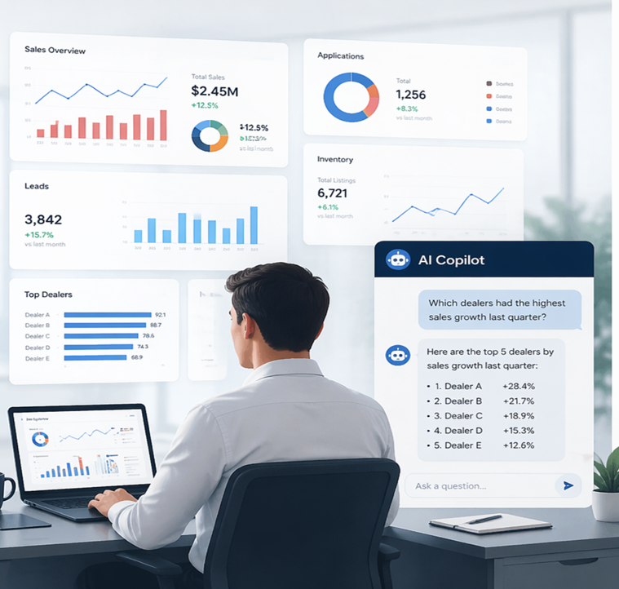
Introduction
In today’s data-driven organizations, timely access to accurate information is essential for effective decision-making.
However, data is often fragmented across multiple systems and dashboards, and reporting requires manual effort and technical skills.
This project introduces an intelligent assistant that allows users to ask questions in plain language and receive instant, reliable insights from a unified data source.
Simplifying data access. Accelerating decisions. Empowering people.
source; Author
Notes:
Pointers :
Decision-making depends heavily on access to accurate data.
The data is often fragmented across multiple systems, making it difficult and time-consuming to access.
3. Introduces an AI-powered assistant that allows users to ask questions in natural language and receive instant, reliable insights from a unified data source.

Slide 4
Literature Review
Agentic AI Systems & Taxonomy
Provides a structured understanding of AI agents, their capabilities, and challenges in real-world applications
(Sapkota et al., 2025)
LLM-based Autonomous Agents
Demonstrates how large language models can act as autonomous agents for complex task execution
(Wang et al., 2025)
Tool-Augmented Reasoning (ReAct Framework)
Combines reasoning and tool usage to improve accuracy and grounded decision-making
(Yao et al., 2023)
Multi-Agent & Tool Integration Systems (AutoGen)
Enables LLMs to interact with tools and collaborate to solve complex analytical tasks
(Wu et al., 2023)
Existing approaches either focus on analytics or intelligent agents, motivating the need for a unified agentic system for dealer performance analysis.
Notes:
Pointers;
Previous research has explored agentic AI systems, LLM-based agents, and tool-augmented frameworks such as ReAct and AutoGen. These approaches show strong capabilities in reasoning and task execution.
However, most of them do not integrate directly with domain-specific analytics systems, which creates a gap that this study aims to address.

Slide 5
Problem Statement
Data needed for decision-making is spread across multiple systems, making it difficult and time-consuming to access.
Reporting often requires manual effort and technical expertise, which delays insights and reduces efficiency.
1.
DATA SCATTERED
2.
TIME DELAY
3.
COMPLEXITY
Data is spread across multiple systems and dashboards.
Generating insights requires manual effort, which delays access to important information.
Understanding the data often requires technical skills, limiting who can use it effectively.
Notes:
The main problem is that data needed for decision-making is fragmented across multiple systems. (multiple dashboards & manual reporting )
Results into;
1. delays because reporting is often manual.
2. Introduces complexity, as users need technical skills to access and interpret the data
3. Thereby making decision-making slow and inefficient.

Slide 6

Objectives
This study aims to design an Agentic AI Copilot that:
● To create a unified dealer performance view by integrating listings, leads, applications and sales into a consistent dealer-level overview
● To design and implement an agentic AI system that can interpret user requests, plan the necessary steps and retrieve dealer operations data from a database
● To implement data-grounded reasoning through retrieval and scoring with traceable explanations
● To establish an appropriate non-agent baseline and compare it to the proposed agentic approach
● To design a frontend interface(chatbot) for bot the baseline system and the proposed system for prompting
Notes:
1.Bring together different types of dealer data, such as listings, leads, applications, and sales, into one unified view.
2. Build an intelligent assistant with agentic AI that helps users easily understand dealer performance without needing technical skills. (all the user needs to do is put in a request in plain English language)
3. the system ensures that all answers are accurate and based on real data by using structured retrieval and scoring methods.

Slide 7
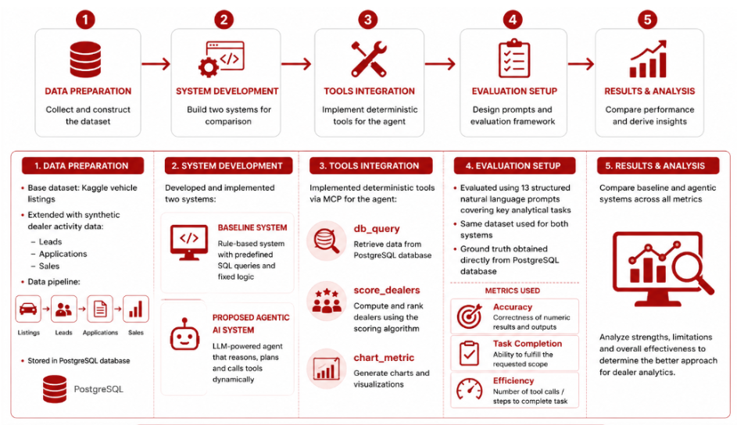
Methodology
SYSTEM DESIGN
● Fair comparison of two systems:
○ Baseline (rule-based)
○ Proposed agentic system
● Using the same dataset
● Using the same evaluation prompt
● Using the objective ground truth from the database
source; Author
Notes:
To achieve these systems ;
First, data preparation (data was constructed using Kaggle vehicle listings and extended with synthetic dealer activity such as leads, applications and sales )
2. Secondly, there is system development, two systems were built :
. A baseline system
A proposed agentic AI system for comparison
3. Thirdly, we move to the tools integration where deterministic custom tools (explain deterministic) such as database querying , dealer scoring and chart generation were implemented to support agent
4. Evaluation set up
. (both system were tested using the same database and a set of structured prompts )
. 13 natural language prompts (key analytical tasks)
. Our ground of truth obtained directly from PostgreSQL
. Both systems were compared using three metrics

Slide 8

Dataset Construction
● Base dataset from Kaggle vehicle listings
● Extended with synthetic dealer activity data
Synthetic data includes:
● Leads
● Applications
● Sales
Data pipeline:
Listings → Leads → Applications → Sales
Integration into a PostgreSQL database
Notes:
The origin of the dataset was from a public listings dataset was obtained from Kaggle and includes Malaysian car listings originally gathered from Oto. My
It had 920 rows and 18 columns covering fields such as vehicle price, date posted, title
With a python script , this public dataset was cleaned to suit that of Autochek Africa and extended into several other tables including leads, applications and sales (reflective of the Autochek Africa data)
These were structured into a pipeline from listings to sales and stored in a PostgreSQL database.(dealer ai)

Slide 9
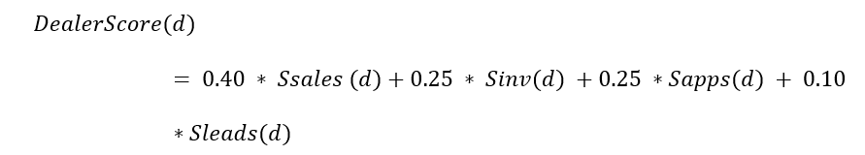
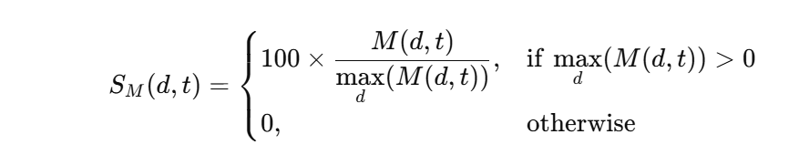
Dealer Scoring Method
Weighted scoring :
● Sales = 0.40
● Inventory = 0.25
● Application = 0.25
● Leads = 0.10
Four Performance Metric Uses :
● Sales Performance
● Inventory Activity
● Application Volume
Each metric is normalized to a 0-100 scale :
Notes:
Insights on dealers performance
. The metrics captures different aspects of dealer performance , from actual sales to customer interest
. Since these metrics are on a different scale , I normalized to a range of 0-100(this ensures that all metrics are comparable and no single metric dominates due to its scale )
. After normalization , there was a weighted scoring applied
Sale =
Etc
Finally, the overall dealer score is computed as a weighted average of these normalized metrics.
This approach ensures a balanced and fair evaluation of dealer performance.

Slide 10

Baseline System
(Rule Based Approach)
● Implemented using predefined rules and templates
● Uses fixed SQL queries for data retrieval
● Matches user queries to known patterns
● Produces deterministic outputs (same input → same result)
Limitation:
● Limited to predefined query types
● Cannot adapt to complex or ambiguous requests
Notes:
The baseline system is a rule-based system that operates using predefined rules and fixed SQL query templates.
This means that for each type of user request, the system has a specific pattern it recognizes and a corresponding SQL query that it executes.
Because of this, the system produces deterministic outputs, meaning that the same input will always result in the same output, with no variation.
Limitations
It can only handle queries that match its predefined patterns.
If a user asks a complex question, combines multiple conditions, or phrases the request in an unexpected way, the system cannot adapt and may fail to produce a correct response.
This highlights the rigidity of rule-based systems, as they lack flexibility and cannot generalize beyond predefined logic.

Slide 11
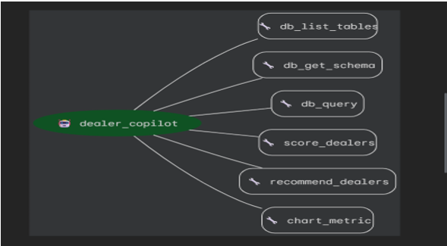
Proposed Agentic System
● Uses a Large Language Model (LLM) for interpretation
● Converts natural language into structured actions
● Dynamically selects and calls tools
Core tools include:
● db_query for data retrieval
● score_dealers for performance ranking
● chart_tool for visualization
Key Principle:
● LLM handles reasoning
● Tools ensure correctness and grounded outputs
source; google adk web cli
Notes:
The proposed system is an agentic AI system that uses a Large Language Model as well as custom tools to interpret user queries. (the Agent is the brain , the tools are the hands (has an LLM fall back )
It does rely on predefined rules, the system understands user requests expressed in natural language, even when they are complex or phrased in different ways.
It then converts these requests into structured actions. For example, it may decide to retrieve data, compute dealer scores, or generate visualizations.
To do this, the system dynamically selects and calls specific tools such as database queries, scoring functions, and chart generation tools.
The key idea is that the Large Language Model handles the reasoning and decision-making process, while the tools ensure that all outputs are accurate, reliable, and grounded in real data.
This system involves Reasoning and Execution

Slide 12

How It Works
1.
User asks
2.
Understand intent
3.
Extract metrics
4.
Fetch data
5.
Return answer
The agent reads your request, understands intent, extracts the metric and timeline, fetches specific data, and returns an easy-to-understand answer with optional charts. No dashboard hunting, no manual SQL, consistent definitions.
Notes:
1.The system works by first understanding the user’s request,
2.extracting key information such as metrics and time range,
3. retrieving the relevant data, and
4. then returning a clear response (in plain English language), optionally with charts.

Slide 13
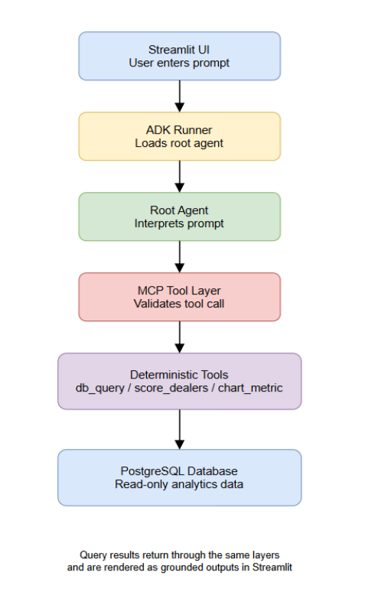
System Architecture
User → UI → Agent → MCP Layer → PostgreSQL Database
Components:
UI: Streamlit interface for user interaction
Agent: ADK-based system for interpreting queries
MCP Layer: Enforces read-only and safe database access
Database: PostgreSQL storing dealer activity data
Notes:
The process begins at the user interface, where the user enters a query in natural language (plain English).
This query is then passed to the agent layer, powered by a Large Language Model, which interprets the request and determines the appropriate actions to take.
The agent does not execute tasks directly. Instead, it interacts with a set of predefined tools through a tool layer.
These tools include database querying for retrieving data, scoring functions for ranking dealers, and visualization tools for generating charts.
Each tool performs a specific, well-defined task to ensure accuracy and reliability.
The tools then interact with the PostgreSQL database, which serves as the central data source.
Finally, the results are returned through the same pipeline and presented to the user in a clear and structured format.
This architecture separates reasoning from execution, allowing the system to remain both flexible and accurate.

Slide 14
Demo

Slide 15
Evaluation Setup
13 evaluation prompts (T1–T13)
Same dataset and conditions for both systems
Ground truth computed using PostgreSQL queries
Evaluation metrics:
Accuracy of numeric outputs
Task completion and scope adherence
Efficiency (number of steps or tool calls)
Notes:
The evaluation setup was designed to fairly compare the baseline system and the proposed agentic system.
Both systems were tested using the same dataset and under identical conditions to ensure consistency and eliminate bias.
A set of 13 structured natural language prompts was created to represent typical analytical tasks that a user might perform
.
These prompts included different types of queries, such as data retrieval, ranking, and multi-step analysis.
For each prompt, the expected correct result, or ground truth, was obtained directly from the PostgreSQL database.
This allowed us to objectively verify the correctness of each system’s output.
The systems were then evaluated using three key metrics: accuracy, task completion, and efficiency.
This setup ensures that the comparison is fair, reliable, and reflects real-world usage scenarios.

Slide 16
Evaluation Metrics
1.
ACCURACY OF NUMERIC OUTPUTS (RQ1)
2.
TASK COMPLETION(RQ2)
3.
EFFICIENCY(RQ3)
Measures correctness against PostgreSQL ground truth
Checks:
Correct country filter
Correct metric
Correct date range
Correct numeric value / ranking
Output: Accurate (1) or Inaccurate (0)
Purpose : Ensures results are reliable and not misleading
Evaluates how fully the system answers the prompt
Scoring:
1.0 → Full completion
0.5 → Partial completion
0.0 → Failed
Purpose :
Captures ability to handle multi-step and complex queries
Measures cost of solving each task
Based on:
Number of tool calls (agentic)
Number of processing steps (baseline)
Reported as:
Mean steps per task
Median steps per task
Purpose :
Shows trade-off between flexibility and speed
Notes:
To evaluate the performance of both systems, three key metrics were used: accuracy, task completion, and efficiency.
Accuracy measures whether the system returns the correct numerical result compared to the ground truth from the database.
Task completion evaluates how fully the system answers a query, especially for complex or multi-step requests.
Efficiency measures how many steps the system takes to arrive at a result, which reflects its computational cost and speed.
Together, these metrics provide a balanced evaluation by considering correctness, completeness, and performance.

Slide 17
Results
METRIC
BASELINE SYSTEM
PROPOSED SYSTEM
1
NUMERIC ACCURACY RATE (%)
100%
100%
2
FULL COMPLETION RATE (%)
80%
100%
3
AVERAGE COMPLETION SCORE (0-1)
0.85
1.0
4
AVERGAGE TOOL CALL STEPS PER TASK
2.2
1.15
Notes:
This slide presents the performance comparison between the baseline system and the proposed agentic system.
Both systems achieved 100% numeric accuracy, meaning they were able to return correct results when they successfully executed a query.
However, there is a clear difference in task completion. The agentic system achieved a higher completion rate, meaning it was able to fully answer more queries, especially complex and multi-step ones.
In terms of efficiency, the baseline system required fewer steps on average, making it faster for simple, predefined queries.
On the other hand, the agentic system required more steps because it performs reasoning and tool selection, but this allows it to handle more complex tasks.

Slide 18
Key Findings & Conclusion
1.
2.
3.
Both systems achieve the same numeric accuracy on structured queries
The agentic system performs better on multi-part and complex prompts
The baseline system fails when queries go beyond predefined templates
Key Insight:
Improvement is observed in task completion, not numeric accuracy
Trade-off:
Higher flexibility comes with increased processing steps
The proposed agentic system improves:
Task completion
Flexibility in handling queries
While maintaining:
Numeric accuracy
Safe and controlled database access
Final takeaway:
Tool-grounded agentic systems provide a practical and reliable approach for dealer analytics
Notes:
From the evaluation, several key findings were observed.
First, both systems achieved the same level of numeric accuracy, showing that they are both capable of producing correct results.
Second, the agentic system performed better in terms of task completion, as it was able to handle more complex and multi-step queries.
Third, the baseline system was more efficient, requiring fewer steps to produce results, but it was limited to simple and predefined queries.
Overall, this highlights a trade-off between efficiency and flexibility, where the agentic system provides more comprehensive analytical capabilities.

Slide 19

Thank
You
Presented by :
Regina Adobea Essien

